Slide 1
Midterm Review
PSY 653
Spring 2018

Slide 2
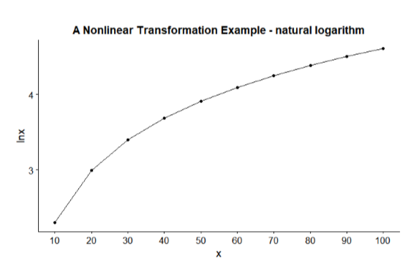
Transformation: Natural Logarithm
The most often used logarithm in statistics is the natural logarithm. The base of the natural logarithm is the mathematical constant e, which is called Euler’s number. It is an irrational number approximately equal to 2.718281828459. The natural logarithm is often abbreviated ln.
logarithm
log_{e}(10) ≈ 2.3026
original value

Slide 3
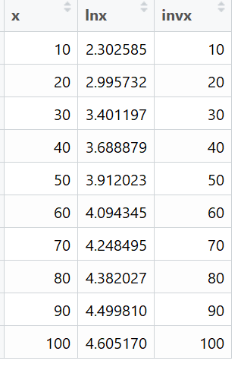
Antilog (Inverse Log)
Once a set of numbers is log transformed (i.e., ln(10) = 2.3026), we can back transform it (called taking the antilog or inverse log), by exponentiating the log transformed value to the base that was used. For the natural log transformation, that means raising e to the power of the transformed value, so e^{2.3026} = 10.
In R, type lnx = log(x)
In R, type exp(lnx)

Slide 4
Transformations
Transformations can be applied to independent variables, dependent variables, or both.
We’ll look at an SLR example where both X and Y are transformed

Slide 5
What if x and y need to be transformed?
There are times when both an x variable and the y outcome need to be transformed. In this example we will consider another variable in the dataset—the ecological footprint of each country (footp). We will examine the relationship between GDP and ecological foot print.
## Example of ln(y), ln(x)
### Transform footp and create a scatterplot matrix of the raw and transformed variables
hp <- mutate(hp, lnfootp = log(footp))
scatterplot <- ggpairs(hp, columns = c("gdp", "footp", "lngdp", "lnfootp"),
upper = list(continuous = wrap("cor", size=3)),
title = "Bivariate Relationship of Raw and Transformed Scores")
print(scatterplot, progress=FALSE )

Slide 6
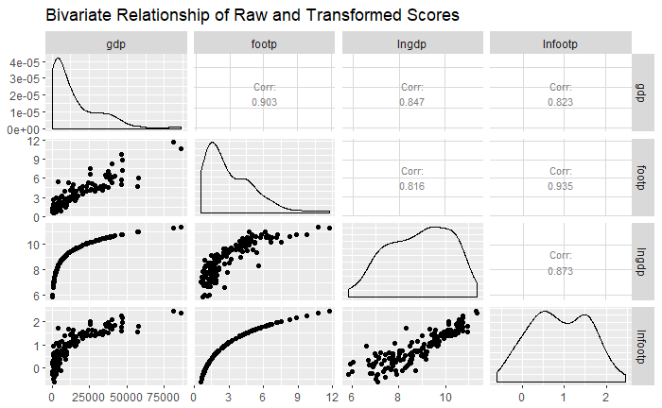
Scatterplot Matrix
The scatterplot of gdp and footp also demonstrates a curvilinear relationship. Transforming just gdp doesn’t help. Transforming both makes the scatterplot look more linear.

Slide 7
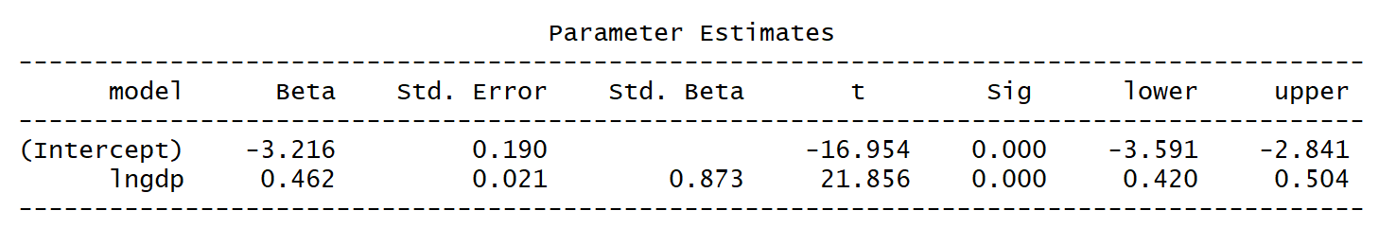
SLR: lnfootp regressed on lngdp
The intercept (-3.216) is the predicted ln(footp) when ln(gdp) = 0.
The slope (.462) is the expected change in ln(footp) for a one unit increase in ln(gdp) It is statistically significant (p-value < .05), indicating that countries with a higher ln(gdp) tend to have a higher ln(footp).

Slide 8
Interpretation for ln(y), ln(x)
This code sets up the function — you don’t need to change anything here. Just execute it to create the function.
### Function to interpret regression slope for ln transformed y and x
ln.xy <- function(slope, x_chg) {
new_slope <- 100 * (exp(slope * (log(1 + (x_chg/100))))-1)
return(new_slope)
}
This code executes the function. You add in the slope you want to interpret (.462 in this case), and the change in x that you want to consider.
### Use function ln.y to interpret parameters
ln.xy(slope = .462, x_chg = 100)
ln.xy(slope = logxy$coefficients["lngdp"], x_chg = 100)
Notes:
In UNIT 8 handout.

Slide 9

Output
A 100% increase in GDP is associated with a 38% increase in the ecological footprint.

Slide 10
Predicted Values & Back Transforming
E.g. What is the ecological footprint for a country with a GDP of 50,000?
1. Find the natural log of X
  ln(50,000) = 10.82
2. Substitute that value into the regression equation
  Lnfootp = -3.21 + 0.46*lngdp
  Lnfootp = -3.21 + 0.46*10.82 = 1.78
3. Find the antilog of the result
  Ln(footp) = 1.78
  footp = exp(1.78) = e^{1.78} = 5.94

Slide 11
Polynomial Regression
In polynomial regression we include squared (x²), cubed (x³) or even higher order terms in order to account for the changing effect of x on y at different levels of x.
This addition of a squared term (i.e., y regressed on x and x², referred to as a quadratic function) allows for one bend of the curve.
The addition of each additional higher order polynomial term allows for an additional bend. For example, y regressed on x, x², and x³ would allow for 2 bends (cubic model).
However, it is rare to see polynomials beyond the second order (x²) in Psychology.

Slide 12
Example: Practice & Performance
We are interested in the effect of time spent in practice on the performance of a visual discrimination task.
There are two variables:
  practice — minutes spent practicing, this was assigned by the experimenter
  score — the number of correct answers on a test

Slide 13
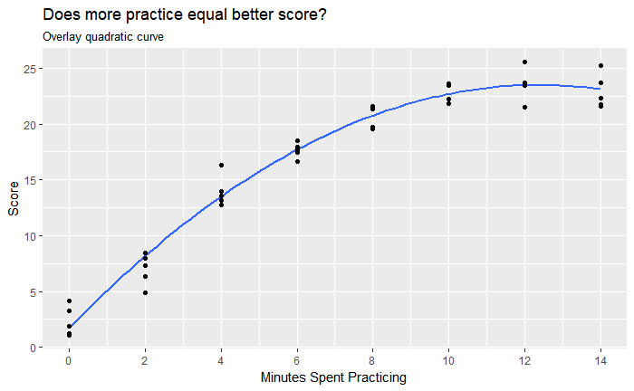
Quadratic Plot

Slide 14
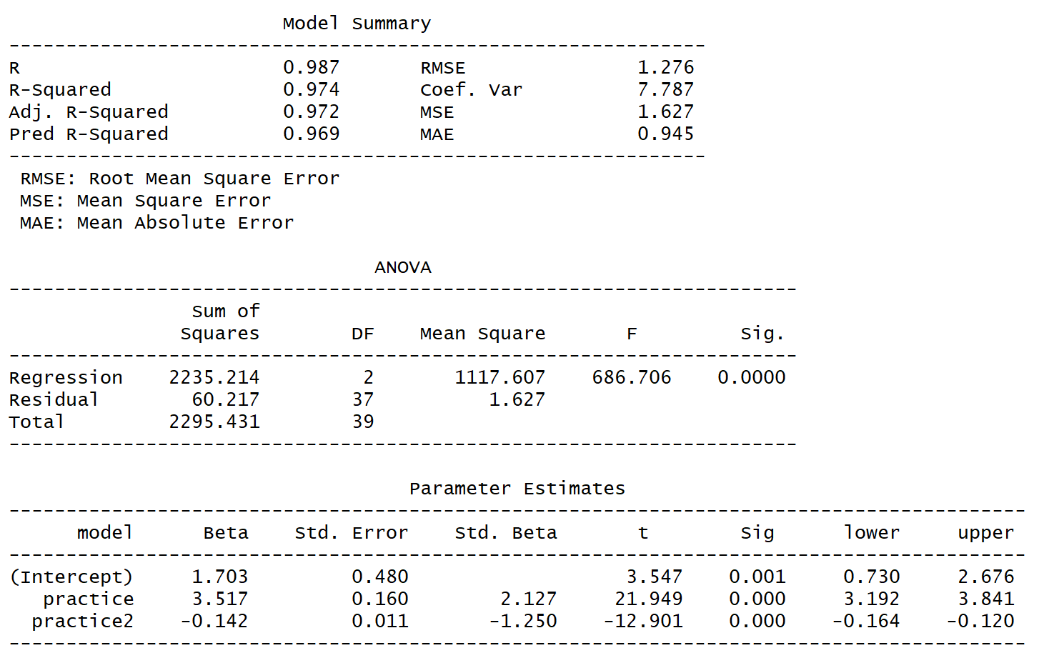
Quadratic Model Results
## Fit a quadratic model
lm_quad <- lm(data = cogtest, score ~ practice + practice2)
ols_regress(lm_quad)

Slide 15
Quadratic Model: Interpretation
Intercept:
  Interpreted just like a regular linear model. (i.e. predicted score when x = 0)
  For individuals who do not practice at all, the expected test score is 1.703
Predicted values:
  Can be calculated by substituting any value for X, just like a regular model
  What is the predicted test score for individuals who practice 10 minutes?
  Y = 1.703 + 3.517*10 – 0.142*10^2 = 22.673

Slide 16
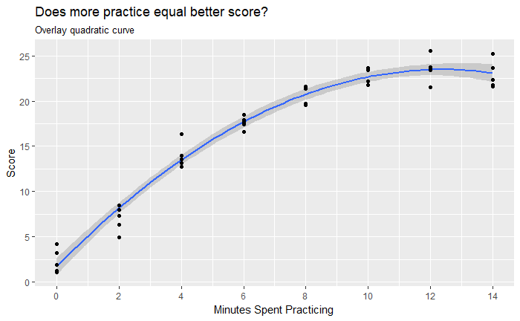
Interpret Quadratic Model: Slopes
b₁
b₂
Slope at 0 min = 3.52
The slope of a line drawn tangent to the parabola at a certain x is estimated by:
b₁+2b₂x_{i}.
So, when practice = 0 the slope is: 3.52 +(2 • -.14 • 0) = 3.52.

Slide 17
Interpret Quadratic Model: Vertex
b₁
b₂
Vertex of parabola is
-3.52/(2 • -.14) = 12.39
There is a value of x along the curve when the slope drawn tangent to the line is 0. In other words, this is the point at which y-hat takes a maximum value if the parabola is a mound or a minimum value if the parabola is a bowl. This point can be estimated with the following formula: -b₁/2b₂. For our example, this is: -3.52/(2 • -.14) = 12.39.

Slide 18
Mediation Example
Hypothesis: greater levels of anxiety lead to greater levels of mental and physical exhaustion, which, in turn, causes performance to deteriorate.

Slide 19
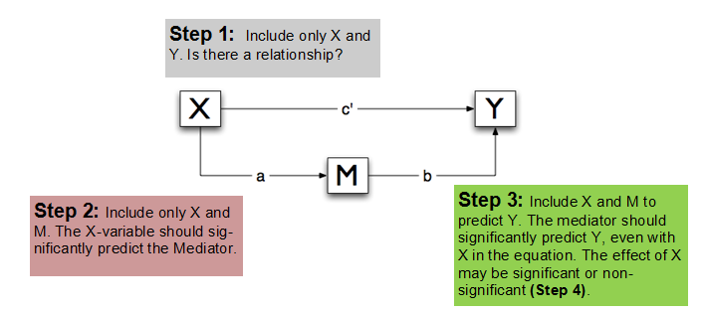
Review: Mediation Steps

Slide 20
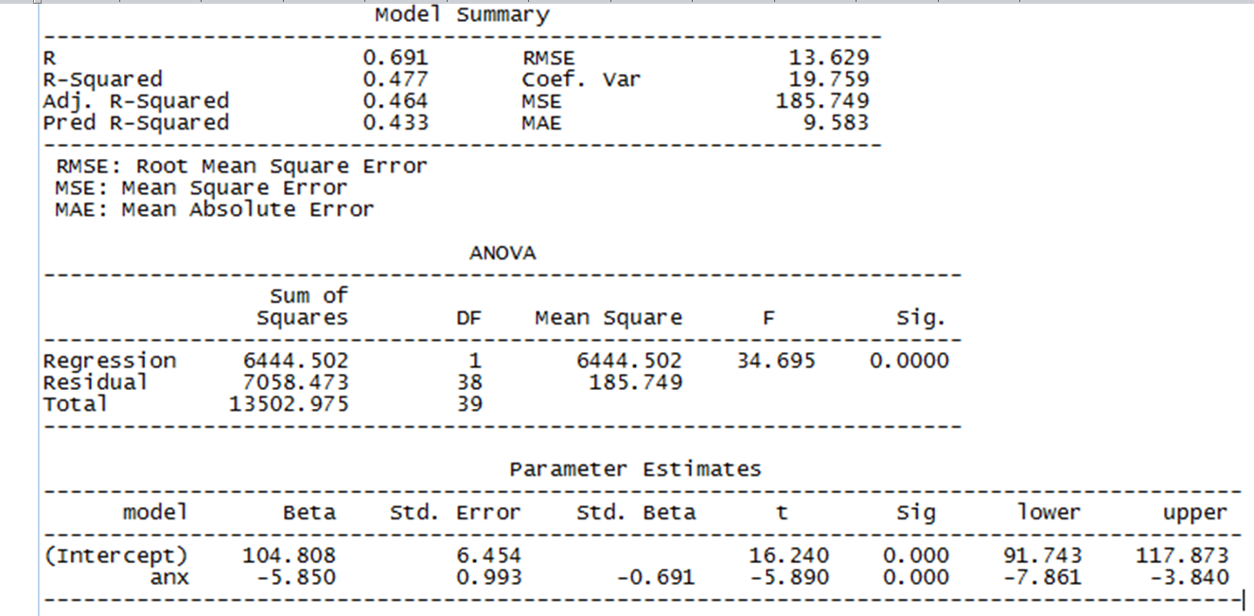
Step 1: Regress Y on X to get c
model.xy <- lm(perform ~ anx , data=mediation)

Slide 21
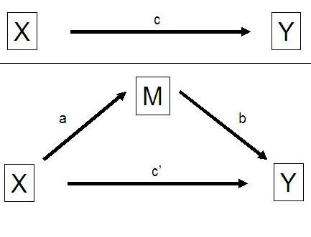
Mediation Figure

Slide 22
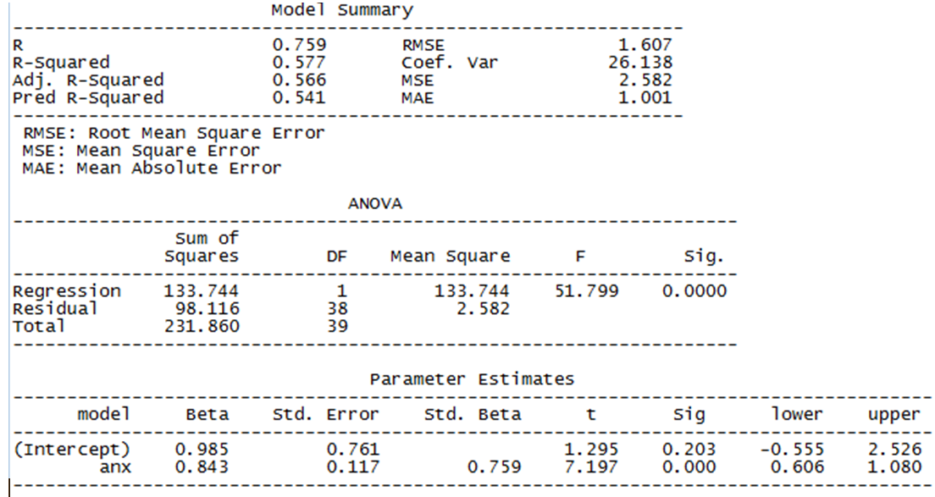
Step 2: Regress M on X to get a path
model.xm <- lm(exhaust ~ anx , data=mediation)

Slide 23
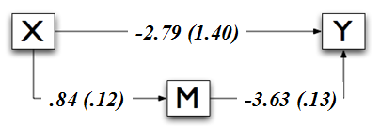
Mediation Figure

Slide 24
Review: Mediation Steps

Slide 25
Mediation Example
Hypothesis: greater levels of anxiety lead to greater levels of mental and physical exhaustion, which, in turn, causes performance to deteriorate.

Slide 26
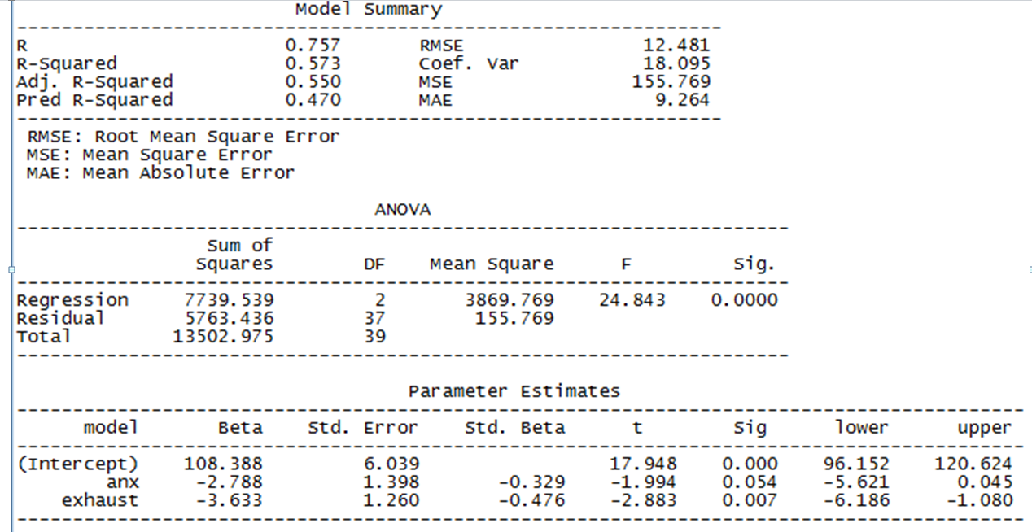
Step 3: regress Y on X and M to get b and c’ paths
model.xmy <- lm(perform ~ anx + exhaust, data=mediation)
Notes:
Because anxirety is nonsignificant (our c’) we can infer that this is full mediation

Slide 27
Mediation Figure

Slide 28
Calculating Indirect Effect
Indirect Effect = a*b
a * b = .843*-3.633 = -3.06

Slide 29
Confidence Interval for Indirect Effect
Method #1: bootstrapping
  See lab activities
Method #2: Rmediation package
  We can use Rmediation::medci() to get a 95% confidence interval for the indirect effect

Slide 30
Extracting Parameters for medci()
coefficients(model.xm)
coefficients(model.xmy)
vcov(model.xm)
vcov(model.xmy)
path.a <- coefficients(model.xm)[“anx"]
path.b <- coefficients(model.xmy)[“exhaust"]
se.path.a<-sqrt(vcov(model.xm)[" anx"," anx"])
se.path.b<-sqrt(vcov(model.xmy)[“exhaust",“exhaust"])
medci(path.a, path.b, se.path.a, se.path.b, alpha = 0.05, plot = TRUE, plotCI = TRUE)

Slide 31
medci()
If you already have the models’ output, simply enter the parameters by hand!
medci(path.a, path.b, se.path.a, se.path.b, alpha = 0.05, plot = TRUE, plotCI = TRUE)
medci(0.84, -3.63, 0.12, 0.13, alpha = 0.05, plot = TRUE, plotCI = TRUE)

Slide 32
Mediation Figure

Slide 33
Effect Size for Indirect Effect
Proportion of the total effect that is mediated by M
  (a · b)/c = (0.84 * -3.63)/-5.85

Slide 34
Sample Interpretation
Exhaustion was examined as a potential mediator of the relationship between anxiety and test performance. The total effect (c path) of anxiety on performance was -5.85, indicating that for every on unit increase in anxiety, performance decreased by 5.85. The effect of anxiety on exhaustion (a path) was statistically significant, indicating that a one unit increase in anxiety is associated with a 0.84 unit increase in exhaustion. The effect of exhaustion on performance (b path) was significant which indicates that, holding anxiety constant, a one unit increase in exhaustion is associated with a 3.6 unit decrease in performance. Multiplying the a path and b path yields the indirect effect of anxiety on performance through exhaustion (c’ path). The magnitude of the indirect effect was -3.06 (95% CI [–.78, -7.96]). Because the confidence interval does not contain zero, the indirect effect is significant. These results support the hypothesis that increases in anxiety lead to exhaustion, which then impairs performance.

